Slide 1
Week 4 Presentation
Sahil Shah

Slide 2
Learn about HMM
Read papers about how Hidden Markov Models work and their application to computer vision

Slide 3
Format Event Annotations
Given annotations for 3 classes (board trick, flash mob, making a sandwich)
Quantize data – give each type of concept a numerical ID
Tabularize data based on video

Slide 4
Train HMM
Use annotation data to generate the maximum likelihood prior, transition and observation matrices
Separate HMM model for each of the three classes

Slide 5
Test HMM
First test was of each video against each of the three models
82 correct classifications out of 88 videos (93% precision)
High precision expected because annotations were done manually for preliminary tests

Slide 6
Test HMM #2
Partition training and testing data using K-Fold for each event (K=5)
testing/training
E001 | E008 | E011
-61 / -411 | -91 / -343 | -$∞$ / -85
-$∞$/-331 | -63 / -372 | -13 / -88
-127/-375 | -77 / -356 | -19 / -84
-115/-363 | -103 / -329 | -13 / -90
-98/-374 | -110 / -326 | -$∞$ / -47
-100 / -371 | -89 / 345 | -15 / 78.8
Log likelihood
Average

Slide 7
Test HMM #3
Forward algorithm (also known as $α$-pass)
Calculate P(O|𝛌) / N^T
Test ID | T | P(O|𝛌) | P(O|𝛌) / N^T
1 | 9 | 5.55e-6 | 10.8
2 | 13 | 2.50e-10 | .305
3 | 7 | 1.48e-6 | .288
4 | 6 | 4.75e-5 | 0.7423
5 | 10 | 4.71e-18 | 4.6e-10

Slide 8
Continuing Work
Look at why the forward probabilities are so low
Look at the effects of varying the number of hidden states
Train this HMM for more annotations to get a better idea of its effectiveness

Slide 9
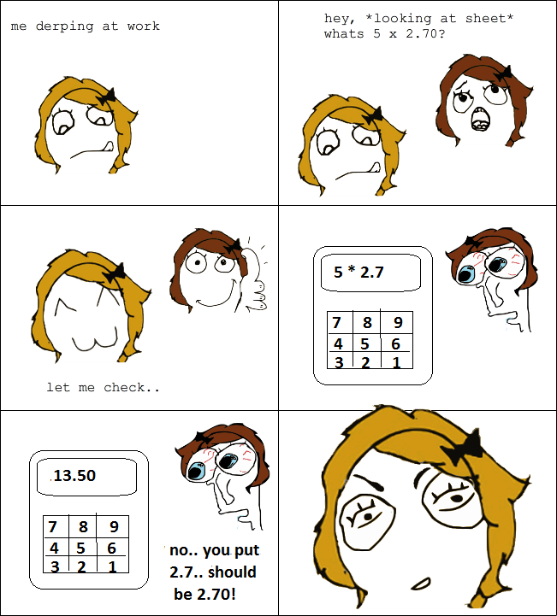
The end

